Slide 1
Is Telemarketing actually an effective sales tactic?
By: Akshay Shembekar, Courtney Golding, Jonathan Littleton, Komal Handa, and Sambhavi Parajuli
Notes:
Courtney

Slide 2

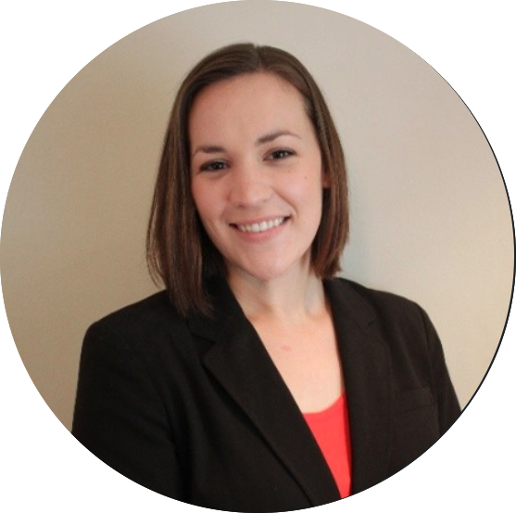



Hello!
We are Team JACKS
Akshay Shembekar
Software Engineer
Courtney Golding
Digital Control Manager
Jonathan Littleton
RPA Developer
Komal Handa
UX Researcher
Sambhavi Parajuli
Strategic Business Analyst II

Slide 3
Decision Making with the Artificial Intelligence (AI) Canvas
1

Slide 4
AI Canvas Project Overview
Prediction
Judgement
Action
Outcome
Predict if a customer will open an account as a result of being included in a telemarketing campaign.
Incorrect predictions would lead to wasted time, resources and money of the bank. Falsely predicting that a customer will open an account would cause the wrong types of customers to be targeted in the campaign. Falsely predicting that a customer wouldn’t open an account would cause the bank to miss out on a potential customer.
To include a particular customer in a telemarketing campaign or not.
Also, to carry out the telemarketing campaign or not.
Accuracy will look at the number of correctly predict values, and F1 score takes into account the precision and recall. F1 measure is also good for imbalanced datasets like this one. We will use F1 score to pick the best model.
Training
Input
Feedback
Data needed to train the model includes customer attributes (ex: age, job, etc.), when and how many times the customer was contacted, and whether or not the customer opened an account.
Data needed to generate predictions includes customer attributes such as age, job, education, marital status, etc.
As additional campaigns are carried out, additional customer data and outcomes would improve the model. The current data is imbalanced, so additional data for customers who chose to open an account would cause improvements.
How will this AI impact the overall workflow?
Telemarketing campaigns can be carried out in a more targeted way to reduce the amount of time and resources allocated for each campaign. Additionally, campaigns may be carried out more or less frequently depending on results.

Slide 5
Exploratory Data Analysis (EDA) and Preprocessing
2
Notes:
Jonathan

Slide 6
Data Set & Features
The data is related with direct marketing campaigns of a Portuguese banking institution.
The marketing campaigns were based on phone calls. Often, more than one contact to the same client was required.
The goal of the campaign was to get consumers to subscribe to a bank term deposit.
Link to data set: Telemarketing Data
11 Categorical Features in the Data Set:
job : Describes Job of the potential client
marital status: Describes Marital status of the potential client
education : Describes Education of the potential client
default : Represents whether the potential client has credit in default
housing : Represents whether the potential client has housing loan
loan : Represents whether the potential client has personal loan
contact : Represents type of communication channel used
month : Indicates the month when the potential client was last contacted
day_of_week : Indicates the last contact day of the week of the month when contacted
poutcome : Indicates the outcome of the previous marketing campaign
y : binary column indication whether has the 'potential' client subscribed a term deposit
10 Numerical Features in the Data set:
age : Integer value for Age of the potential client
duration : Indicates last contact duration (in seconds)
campaign : Indicates the # of times potential client was contacted
pdays : Indicates number of days since last contacted from a previous campaign
previous : Indicates the # of times potential client was contacted, previously
emp.var.rate : Shows the 'quarterly' employment variation rate
cons.price.idx : Shows the 'monthly' consumer price index
cons.conf.idx : Shows the 'monthly' consumer confidence index
euribor3m : Shows the 'daily' euribor 3 month rate
nr.employed : Shows the 'quarterly' number of employees employed

Slide 7
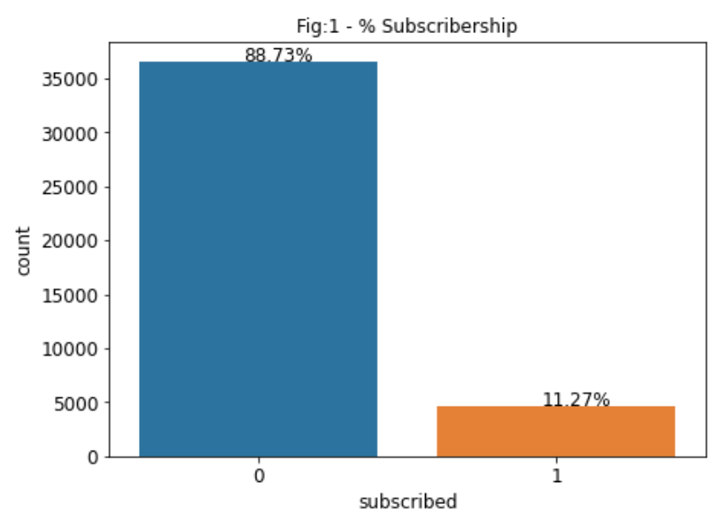
Distribution of Data
This data set is an imbalanced data set which has 88.73% of class variable 0 and 11.27% of 1.
Class distribution is not uniform among the classes in the imbalanced dataset, so the model will be biased towards the majority class
Stratified sampling will be used to split the data into train and test data sets
The train and test sets will have an equal percentage of “subscribed” and “not subscribed” samples
0: the customer did not subscribe to a term deposit
1: the customer did subscribe to a term deposit

Slide 8
Null Values
The following features have null values:
Default (8597 null values)
Job (330 null values)
Marital (80 null values)
Education (1731 null values)
housing (990 null values)
Loan (90 null values)
20.8% of the total values for “Default” are null
Results of Chi-Square test indicate a dependency between the amount of unknown default values and the outcome, so the rows with null values should not be deleted
Remaining variables have less than 5% null values
Values for the features with null variables will be imputed using the most common values

Slide 9
Feature Removal and Manipulation
Variables Removed:
Housing
Crosstab table shows no relationship between “housing” and “subscribed”
Duration
Can not be used in the model for predicting outcomes, because the duration of the call will not be known until after the call is complete
Pdays
The value "999" was used in the pdays columns when a customer was not previously contacted, which will impact the model.
Other features such as "Campaign" and "Previous" indicate if a customer was previously contacted, so pdays is not necessary
Variables Modified
Loan
The new variable "Has Loan" will have a value of 1 if the customer has either a Housing loan or Personal loan, and a value of 0 if the customer has no loans
Education
The education levels of basic.4y, basic.6y and basic.9y have been converged into one-single category called basic

Slide 10
Model Training, Tuning, and Selection
3
Notes:
Sambhavi

Slide 11
Baseline Prediction using DummyClassifier/Model Free Baseline/Naive Classifier
Baseline prediction is the simplest possible prediction and a dummy classifier is used to make predictions using simple rules.
For imbalanced dataset, Stratified strategy is used which generates predictions by respecting the training set’s class distribution
Baseline Accuracy Score : 79.7%

Slide 12
Methods Tested
DECISION TREE
A decision tree is a machine learning algorithm that partitions the data into subsets. The partitioning process starts with a binary split and continues until no further splits can be made. Various branches of variable length are formed.
XGBOOST
Gradient Boosting is an approach where new models are created that predict the residuals or errors of prior models and then added together to make the final prediction. It is called gradient boosting because it uses a gradient descent algorithm to minimize the loss when adding new models.
A random forest is a meta estimator that fits a number of decision tree classifiers on various sub-samples of the dataset and uses averaging to improve the predictive accuracy and control over-fitting.
RANDOM FOREST
The PCA does an unsupervised dimensionality reduction, while the logistic regression does the prediction.
The PCA converts data from high dimensional space to low dimensional space by selecting the most important attributes that capture maximum information about the dataset and logistic regression method is used to train the model.
LOGISTIC REGRESSION WITH PCA

Slide 13
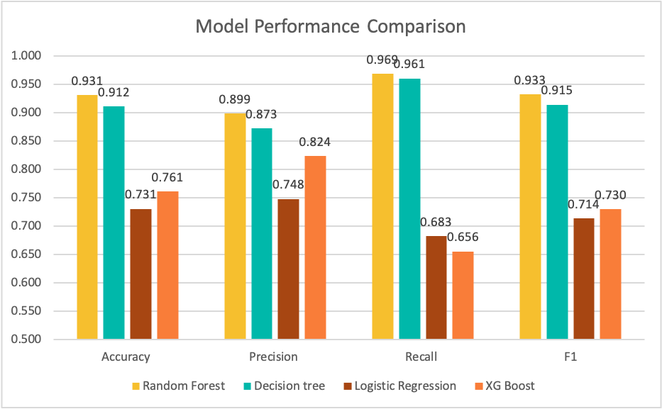
Model Performance Metrics
Random forest was the best performing model with all metrics.
F1 score, precision, and recall were more significant for this dataset than accuracy because it is imbalanced.

Slide 14
Hyperparameter Tuning
Parameter | Values | Purpose | Optimal Values
Criterion | Gini (impurity) or Entropy (information gain) | Measure the quality of a the split | Entropy
Num Estimators | integer | The number of trees in a forest | 150
Max Depth | Integer | The maximum depth of the tree; if unspecified, will keep splitting until all leaves are pure | 35
Min Samples Split | Integer | Minimum number of samples required to split an internal node | 10

Slide 15
Demo
4
https://telemarketing-effect.herokuapp.com

Slide 16
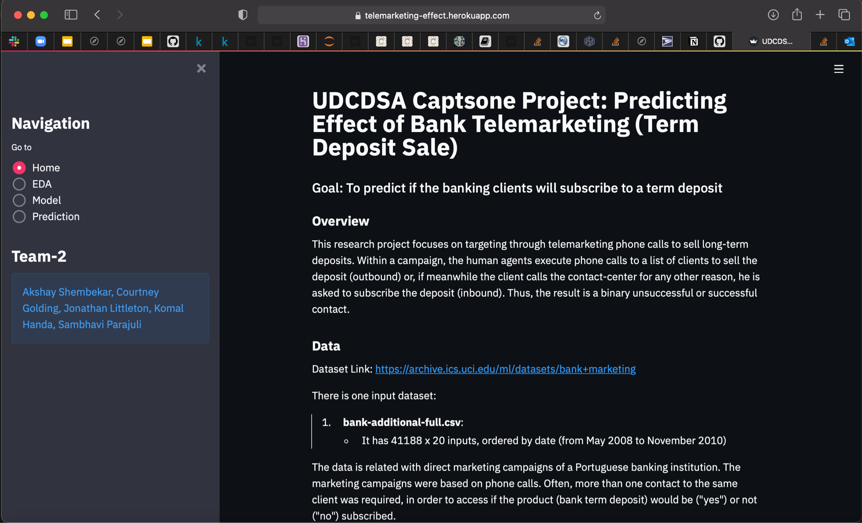
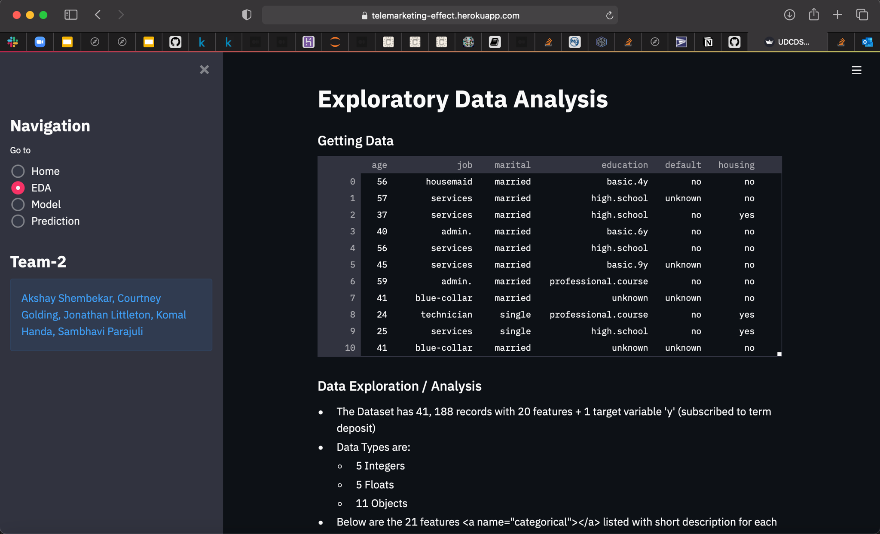
Demo - Home & EDA
4.1
Notes:
Akshay

Slide 17
Insights and Conclusion
5
Notes:
Komal

Slide 18
Key Insights
The average success rate of telemarketing campaigns is 2.5%. Based on this dataset, this bank had an above average success rate, at 11% of calls leading to a successful subscription of a term deposit.
While the bank had an above average success rate, email marketing campaigns have an average response rate of 10.6%. The bank may want to consider allocating resources towards email campaigns in addition or in place of telemarketing, as it can reach a higher volume of consumers quickly and using less resources.
Average Response Rates by Campaign Type:
Email: 10.6%
Mail: 0.5 - 2%
Paid Search: 0.5 - 2%
Display Ads: 0.05 - 0.1%
Assuming that the average telemarketer salary is €7 in Portugal and the average call duration is 4.3 minutes, these 41,000+ calls cost the bank approximately €20,678. Approx €18,348 can be lost on unsuccessful telemarketing calls.
Notes:
Data Sources:
https://www.campaignmonitor.com/resources/guides/email-marketing-benchmarks/
https://www.postgrid.com/direct-mail-response-rate/
https://www.smartinsights.com/managing-digital-marketing/planning-budgeting/marketing-campaign-response-rates/
https://www.leadfeeder.com/blog/cold-calling-is-dead/
Komal

Slide 19
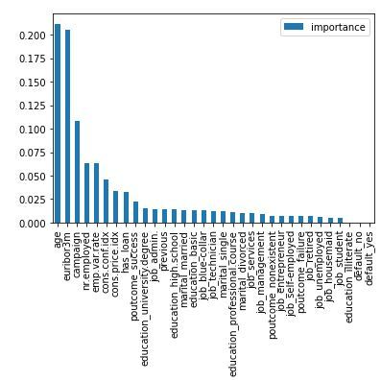
Conclusions
If the bank would like to optimize their telemarketing efforts, they should focus on these types of customers, which had a higher impact on the success rate.
Age: 20-40
Targeted in previous campaign: Yes
Number Employed: 5,000
Has loan: No
Previous success: Yes
Education: University Degree
Other socio-economic factors like the Euribor rate, Consumer Confidence Index, and Consumer price index also had high importances, but cannot be easily modified by the bank like the customer based features.
Notes:
Komal

Slide 20
Thank you!

Slide 21
Appendix
6

Slide 22


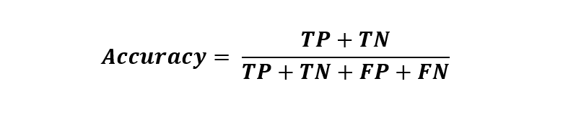

Metric Definitions
Precision:
Out of all the positives predicted - the truly positive percentage
Recall:
Out of the total positive, what percentage are predicted positive
Accuracy
How often a point is classified correctly
F1 Score:
Harmonic mean of precision and recall. It takes both false positive and false negatives into account. Therefore, it performs well on an imbalanced dataset.
Notes:
Source: https://towardsdatascience.com/performance-metrics-confusion-matrix-precision-recall-and-f1-score-a8fe076a2262

Slide 23
Conclusion Cost Calculation
Average Salary for a telemarketer | € 7.00
Salary/min | € 0.12
Average minutes for a call | 4.304750167
cost per call | € 0.50
Unsuccessful calls | 36535
Successful calls | 4639
Unsuccessful call Cost | € 18,348.64
Successful call cost | € 2,329.80

Slide 24
Chi - Squared
A Chi-Square test is a test of statistical significance for categorical variables. It helps to understand the relationship between the categorical variables of the dataset.
It is used to analyze the dependence of one category of the variable on the other independent category of the variable. Chi-squared test is performed between categorical variable and class variable.
The null hypothesis -The grouping variables have no association or correlation amongst them.
The alternate Hypothesis-The variables are associated with each other and happen to have a correlation between the variables.
Notes:
https://www.slidescarnival.com/viola-free-presentation-template/414 - presentation template

